Slide 1
Discussion panel
Data Flow Assessment Framework
Moderated by Rajiv Ranjan, PARIS21
18
Panellists:
Fadhila Najah, INS
Yves Jaques, UNICEF
Trevor Fletcher, Independent Consultant SIS Modernisation

Slide 2
data FLOW Assessment Framework (DFAF)
Rajiv Ranjan
Technical Programme Advisor
2019 COMMUNITY WORKSHOP: THE NEW .STAT SUITE – ‘FROM IDEA TO REALITY’

Slide 3
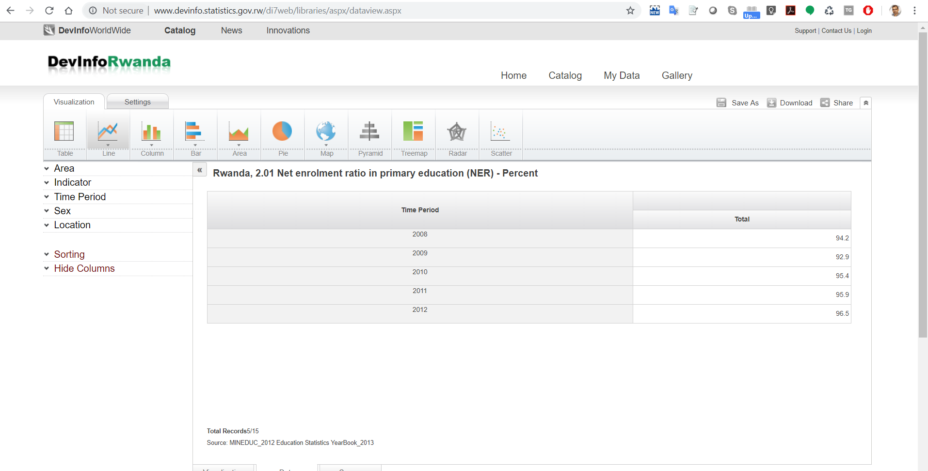
Dissemination on digital platforms?
How dissemination on digital platforms currently looks like in many NSOs
Printed reports
Manual data Entry

Slide 4
Problem
Solution
Delayed data
Less data
Erroneous data
A solution that can tap the data "when it is in the digital format for the first time”

Slide 5
Issues
Dissemination processes are different in different NSOs (variables are process, practice, capacity, infrastructure)
Solutions which do not take into consideration the local context do not deliver

Slide 6
Data Flow Assessment Framework
Set of steps for assessing the process, practice, capacity and infrastructure (to understand “as-is” situation)
Recommendation on resolutions (“to-be” situation)
Assessment guidelines
Template for assessment report and a follow-up project plan

Slide 7
Data Flow Assessment Framework
Steps for assessment
Assessment of indicator availability and their organisation
Delineating “as-is” process flow for indicator dissemination on digital platforms
Assessing the dissemination platforms currently in use, their main features, advantages and disadvantages
Presence and need of data modelling practice
Assessing general IT infrastructure including data bases

Slide 8
Discussion panel
Data Flow Assessment Framework
Moderated by Rajiv Ranjan, PARIS21
18
Panellists:
Fadhila Najah, INS
Yves Jaques, UNICEF
Trevor Fletcher, Independent Consultant SIS Modernisation

